Slide 1


CSCE 5640 Operating System Design Synchronization Tools
Dr. Amar Maharjan
Computer Science and Engineering
University of North Texas
Slides (with some modifications) from:
Operating System Concepts 10 edition – Silberschatz, Galvin and Gagne © 2018

Slide 2
Outline
Background
The Critical-Section Problem
Peterson’s Solution
Hardware Support for Synchronization
Mutex Locks
Semaphores
Monitors
Liveness

Slide 3
Background
Processes can execute concurrently
May be interrupted at any time, partially completing execution
Concurrent access to shared data may result in data inconsistency
Maintaining data consistency requires mechanisms to ensure the orderly execution of cooperating processes
Cooperating process can either:
Directly share a logical address space (both code and data)
Be allowed to share data only through shared memory or message passing.
Additionally, section 4.2 introduced parallel execution, in which two instruction streams (representing different processes) execute simultaneously on separate processing cores.
Notes:
Access data concurrently.
One process in 1 core, another process in another core. Both are working on the same data.

Slide 4
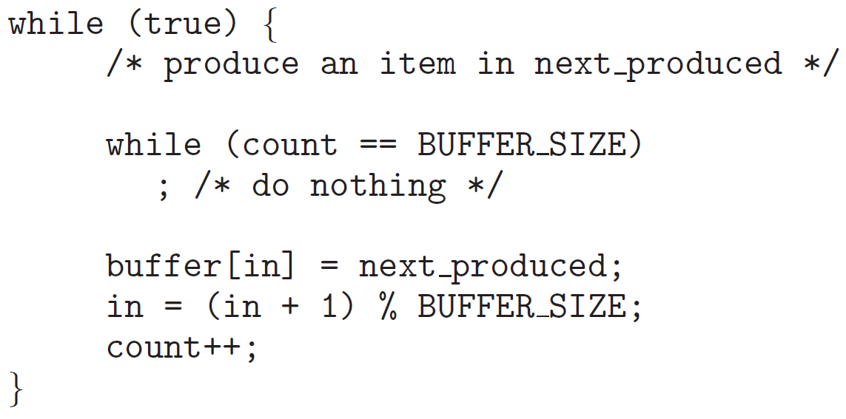
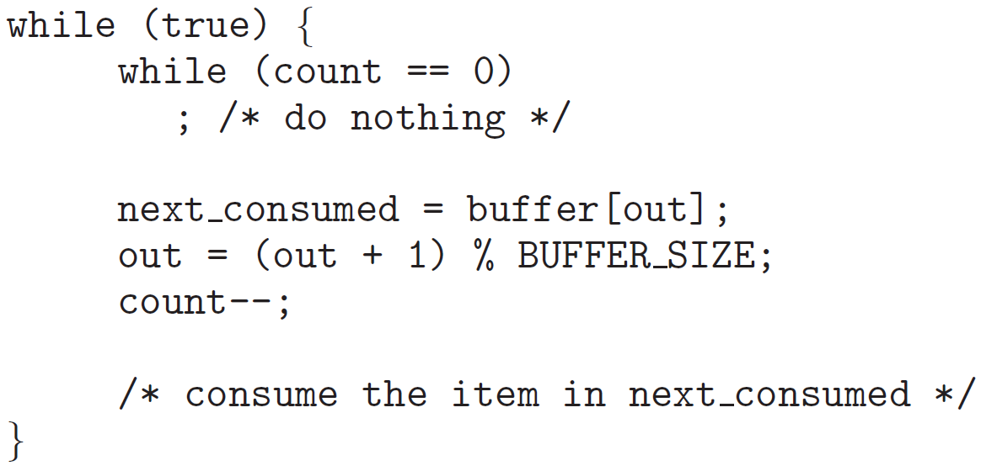
Background (contd.)
In Section 3.5, we described how a bounded buffer could be used to enable processes to share memory - producer–consumer problem.
Notes:
Producer and consumer are sharing data: count, buffer, in and out.
Count: How many items are there in the buffer?
While loop – infinite.

Slide 5
Background (contd.)
Implementation of “count++”
register1 = count
register1 = register1 + 1
count = register1
Implementation of “count--”
register2 = count
register2 = register2 − 1
count = register2
Notes:
If these three are not atomic then there can be a problem.
If these three instructions are not implemented in sequence properly, then there is a problem.

Slide 6
Background (contd.)
An example of interleaving (assume count == 5 currently):
T0: producer execute register1 = count {register1 = 5}
T1: producer execute register1 = register1 +1 {register1 = 6}
T2: consumer execute register2 = count {register2 = 5}
T3: consumer execute register2 = register2 −1 {register2 = 4}
T4: producer execute count = register1 {count = 6}
T5: consumer execute count = register2 {count = 4}
Notice that we have arrived at the incorrect state “count == 4”, indicating that four buffers are full, when, in fact, five buffers are full.
If we reversed the order of the statements at T4 and T5, we would arrive at the incorrect state “count == 6”.
Situation: Race condition.
Notes:
T2 has happened where it should not happen.
This is a problem, and we will be solving this using synchronization.

Slide 7
Critical Section Problem
Consider system of n processes {p₀, p₁, … p_{n-1}}
Each process has critical section segment of code
Process may be changing common variables, updating table, writing file, etc.
When one process in critical section, no other may be in its critical section
Critical section problem is to design protocol to solve this
Each process must ask permission to enter critical section in entry section, may follow critical section with exit section, then remainder section

Slide 8
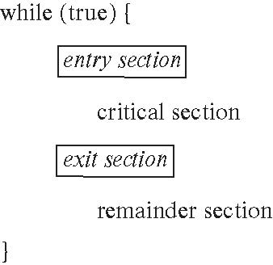
Critical Section
General structure of process P_{i}

Slide 9
Critical-Section Problem (contd.)
Requirements for solution to critical-section problem
Mutual Exclusion - If process P_{i} is executing in its critical section, then no other processes can be executing in their critical sections
Progress - If no process is executing in its critical section and there exists some processes that wish to enter their critical section, then the selection of the process that will enter the critical section next cannot be postponed indefinitely
Bounded Waiting - A bound, or limit, must exist on the number of times that other processes are allowed to enter their critical sections after a process has made a request to enter its critical section and before that request is granted
Notes:
1. Only one process will be accessing the critical section
2. If a process is trying to enter a critical section, then it should not be used infinitely.
3. There should exist a bound to the number of times another process will enter till this process gets to the critical section. This ensures that the process always gets the critical section at some point.
A critical section is important to the user application and also to the OS.

Slide 10
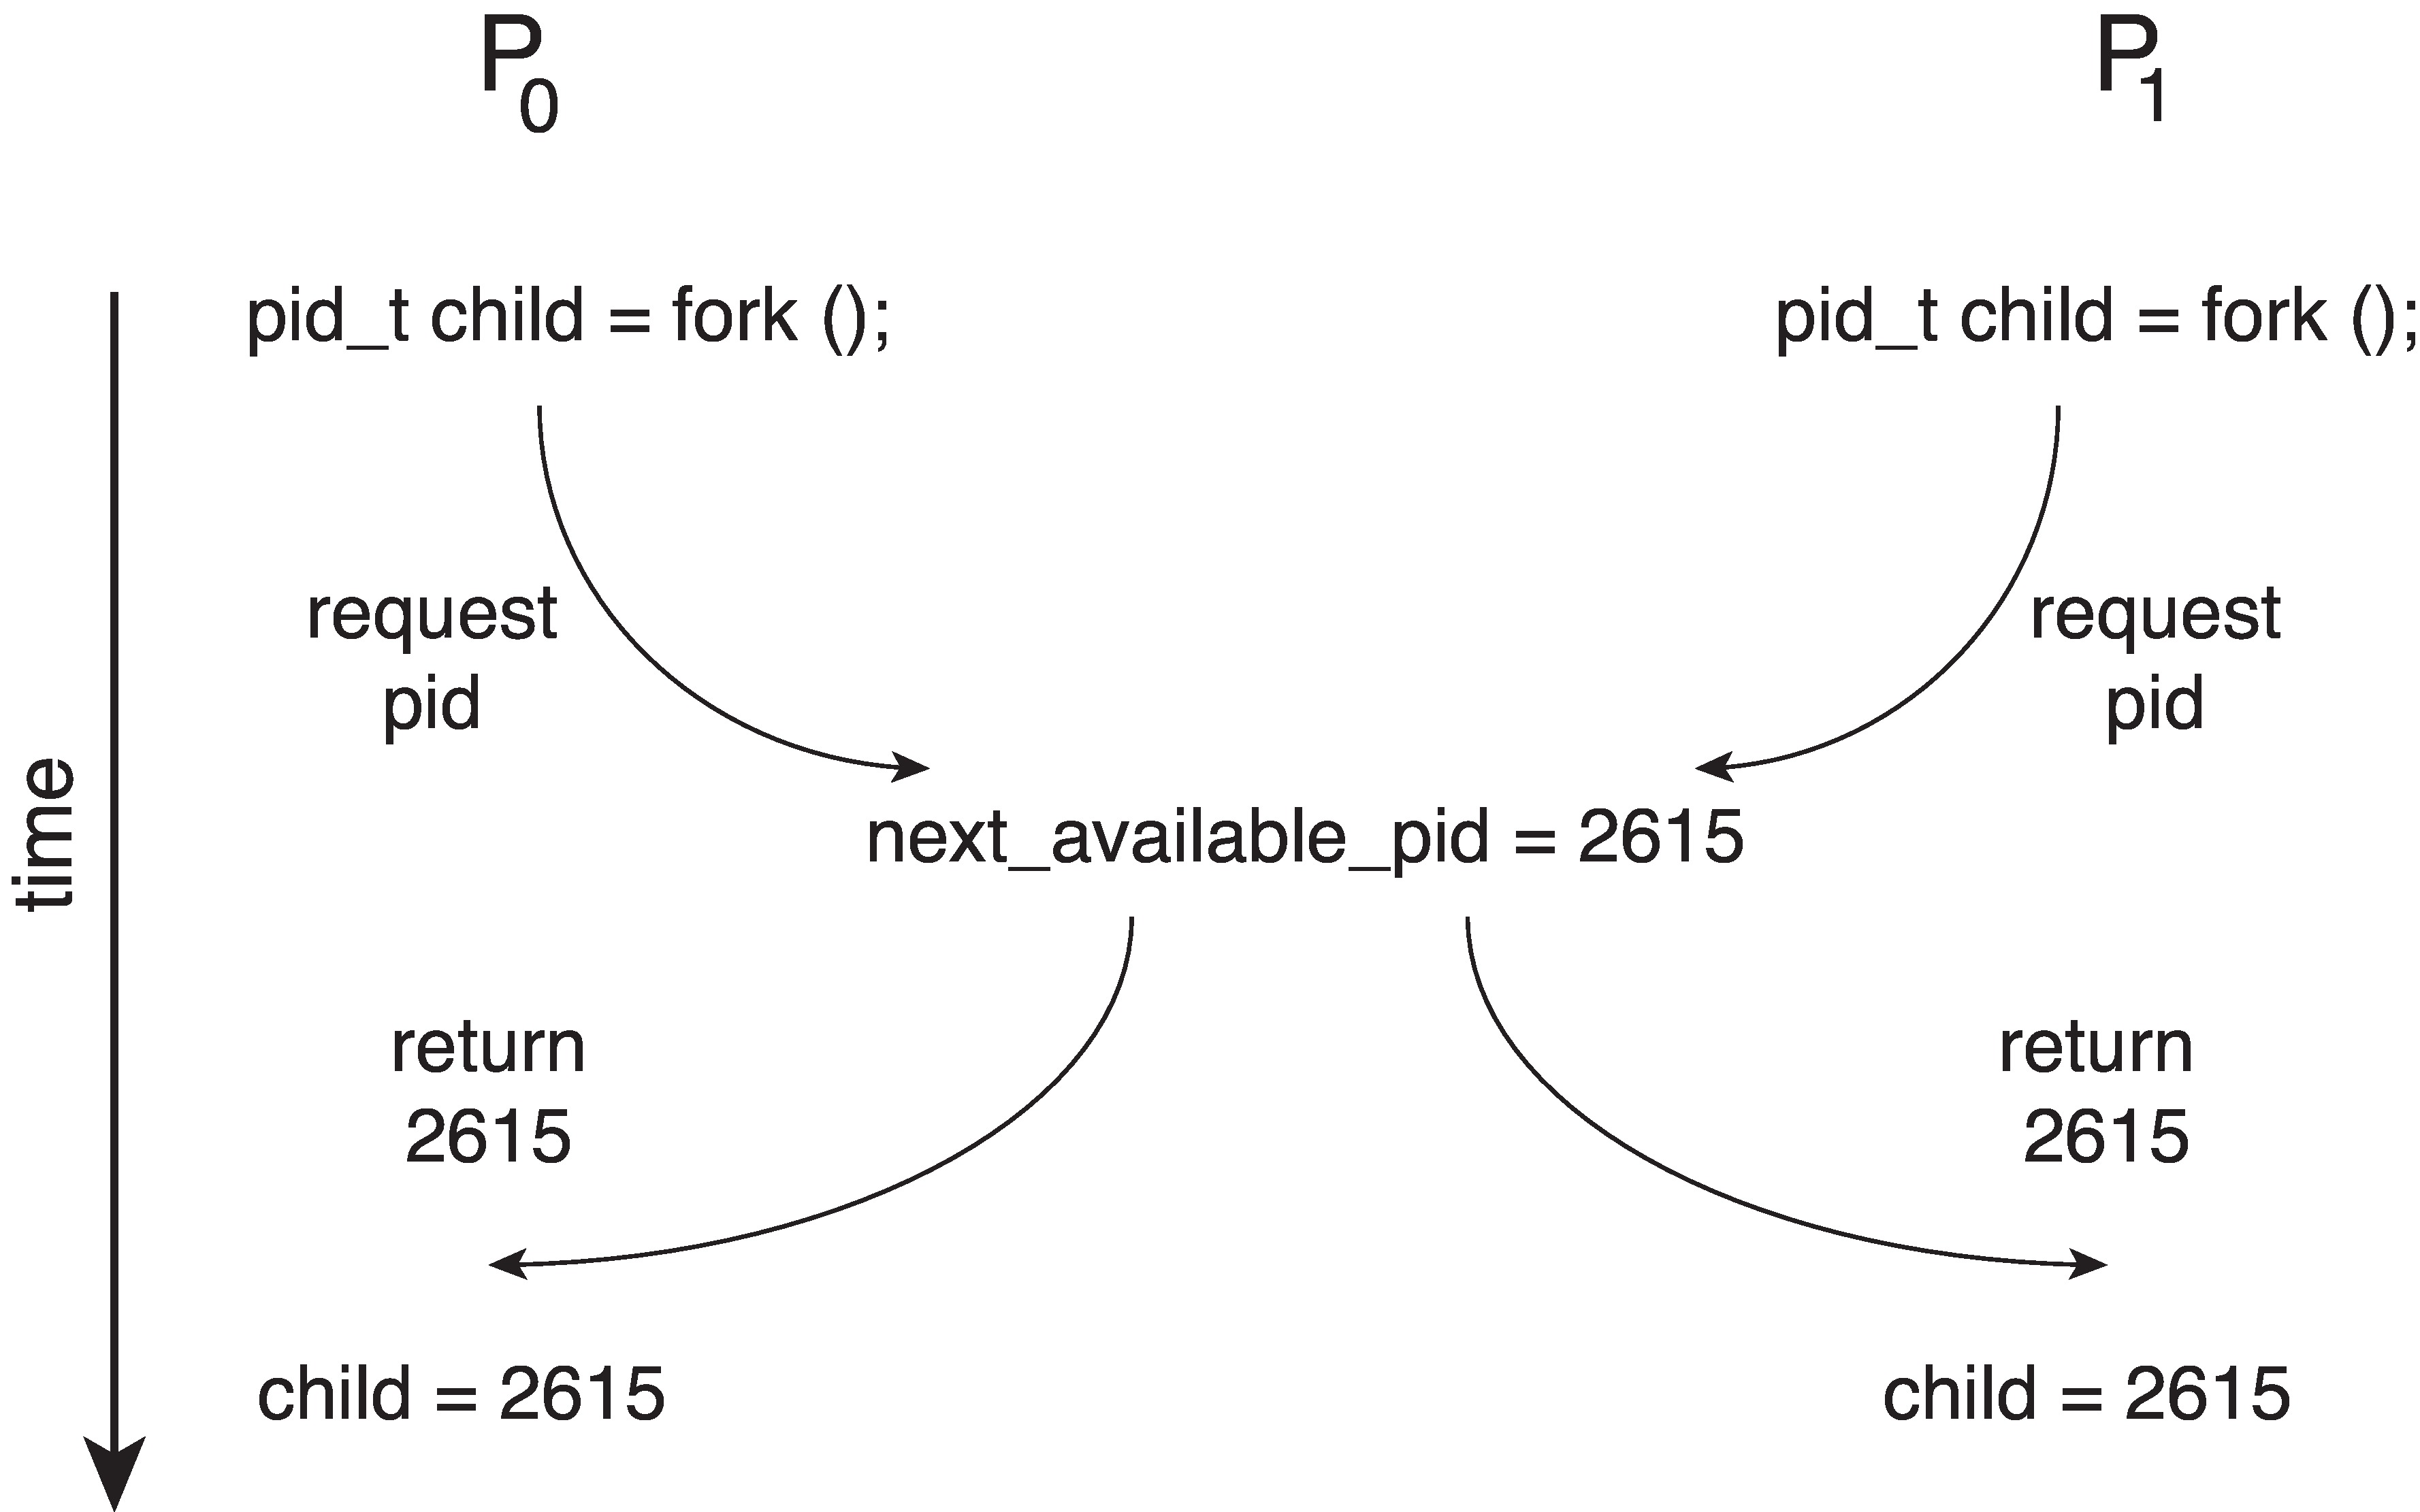
Race Condition
Processes P₀ and P₁ are creating child processes using the fork() system call
Race condition on kernel variable next_available_pid which represents the next available process identifier (pid)
Unless there is a mechanism to prevent P₀ and P₁ from accessing the variable next_available_pid the same pid could be assigned to two different processes!
Notes:
Two children have the same PID, which is a problem both in the user and kernel space.

Slide 11
Interrupt-based Solution
Entry section: disable interrupts
Exit section: enable interrupts
Will this solve the problem?
What if the critical section is code that runs for an hour?
Can some processes starve – never enter their critical section.
What if there are two CPUs?
Notes:
Disabling the interrupt at the entry section will not switch the process to another process, and enable at exit section.
This will solve the problem but its inefficient.
Let's look at efficient solutions. [Next slides]

Slide 12
Peterson’s Solution
Two process solution
The two processes share two variables:
int turn;
boolean flag[2]
The variable turn indicates whose turn it is to enter the critical section
The flag array is used to indicate if a process is ready to enter the critical section.
flag[i] = true implies that process P_{i} is ready!
Notes:
Because of the way modern computer architectures perform basic machine-language instructions, such as and load-store, there are no guarantees that Peterson’s solution will work correctly on such architectures
Turn: Whose turn is to enter the critical section
Turn is 0 or 1
Turn=0: P0 enters
Turn=1: P1 enters
Flag is 0 or 1
Flag[0]: P0 is willing to enter the critical section.
Flag[1]: P1 is willing to enter the critical section.
These variables are accessible to both processes.

Slide 13
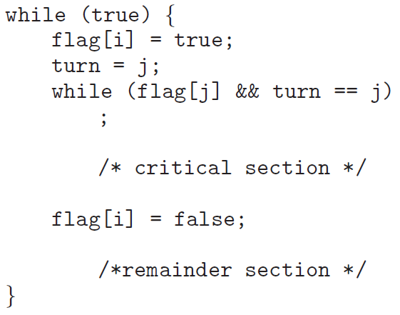
Algorithm for Process P_{i}
Notes:
Box-1: Entry section
Box-2: Exit section
Infinite while loop.
While loop: If other processes want to enter, then give other process changes to enter.
While loop: Spinning lock.
Flag[i] = false; Work is done

Slide 14
Correctness of Peterson’s Solution
Provable that the three CS requirements are met:
1. Mutual exclusion is preserved
P_{i} enters CS only if:
either flag[j] = false or turn = i
2. Progress requirement is satisfied
3. Bounded-waiting requirement is met
Notes:
Peterson’s solution solves all three critical section problems [Slide-9].
If both process wants to enter the critical section – who will enter? – That’s a million-dollar question. Only one enters at a time.

Slide 15
Peterson’s Solution and Modern Architecture
Although useful for demonstrating an algorithm, Peterson’s Solution is not guaranteed to work on modern architectures.
To improve performance, processors and/or compilers may reorder operations that have no dependencies
Understanding why it will not work is useful for better understanding race conditions.
For single-threaded this is ok as the result will always be the same.
For multithreaded the reordering may produce inconsistent or unexpected results!
Notes:
Peterson's solution may not work in modern architecture.
The compiler can re-order the code.
If we do not maintain the order of code in a person's solution, it might not give proper results.
For a single thread, it's fine, but for a multi-thread, it’s a problem.

Slide 16
Modern Architecture Example
Two threads share the data: boolean flag = false; int x = 0;
Thread 1 performs while (!flag) ; print x
Thread 2 performs x = 100; flag = true
What is the expected output?
100

Slide 17
Modern Architecture Example (contd.)
However, since the variables flag and x are independent of each other, the instructions:
flag = true; x = 100;
for Thread 2 may be reordered
If this occurs, the output may be 0!
Notes:
The compiler can re-order the instructions as above.

Slide 18
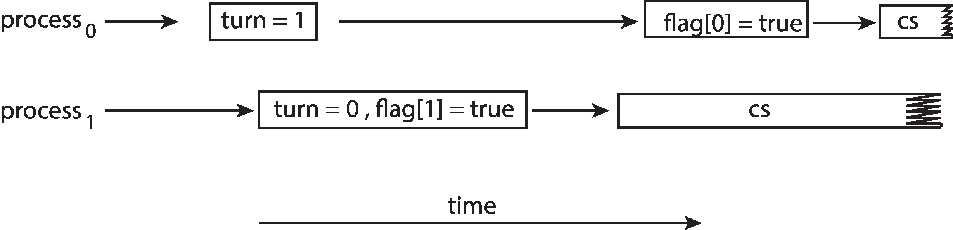
Peterson’s Solution Revisited
The effects of instruction reordering in Peterson’s Solution
This allows both processes to be in their critical section at the same time!
To ensure that Peterson’s solution will work correctly on modern computer architecture we must use Memory Barrier.
Notes:
In Peterson’s solution, if we re-order the turn and flag (turn 1st and then update the flag), then it will fail to work.
Both processes might end up in a critical section at the same time.
To solve this, we use hardware solutions like Memory Barrier.
Loading and storing kinds of instructions should be performed before.

Slide 19
Hardware Support for Synchronization
Software-based solutions are not guaranteed to work on modern computer architectures.
Support of the three hardware instructions for solving critical-section problem:
Memory Barriers
Hardware Instructions
Atomic Variables

Slide 20
Memory Barrier
Memory model are the memory guarantees a computer architecture makes to application programs.
Memory models may be either:
Strongly ordered – where a memory modification of one processor is immediately visible to all other processors.
Weakly ordered – where a memory modification of one processor may not be immediately visible to all other processors.
A memory barrier is an instruction that forces any change in memory to be propagated (made visible) to all other processors.

Slide 21
Memory Barrier Instructions
When a memory barrier instruction is performed, the system ensures that all loads and stores are completed before any subsequent load or store operations are performed.
Therefore, even if instructions were reordered, the memory barrier ensures that the store operations are completed in memory and visible to other processors before future load or store operations are performed.
Notes:
All the above instructions above the barrier will be executed first, and then the below instructions will be executed.

Slide 22
Memory Barrier Example
We could add a memory barrier to the following instructions to ensure Thread 1 outputs 100:
Thread 1 now performs while (!flag) memory_barrier(); print x
Thread 2 now performs x = 100; memory_barrier(); flag = true
For Thread 1, we are guaranteed that the value of flag is loaded before the value of x.
For Thread 2, we ensure that the assignment to x occurs before the assignment flag.
Notes:
We load the value of the flag loaded into the memory before.
Thread 2:
X=100 will be executed first, and then flag=true will happen.
Memory_barrier() must be provided by hardware. They are in sudo (abstract) form here.
If CPU do not support then we cant do anything.

Slide 23
Hardware Instructions
Special hardware instructions that allow us to either test-and-modify the content of a word, or to swap the contents of two words atomically (uninterruptedly.)
Test-and-Set instruction
Compare-and-Swap instruction

Slide 24
The test_and_set Instruction
Definition
boolean test_and_set (boolean *target) {
boolean rv = *target;
*target = true;
return rv;
}
Properties
Executed atomically
Returns the original value of passed parameter
Set the new value of passed parameter to true
Notes:
Whatever value we provide will return the same thing, but it will be set true and return the original value.
Parameter: True; Return True.
Parameter: False; Return False, but the value will be True.

Slide 25
Solution Using test_and_set()
Shared boolean variable lock, initialized to false
Solution:
do { while (test_and_set(&lock))
; /* do nothing */
/* critical section */
lock = false;
/* remainder section */
} while (true);
Does it solve the critical-section problem?
Notes:
Lock = false: Nobody is in the critical section.
Ans: No, No guarantee that the process will enter the critical section. If 5 process is waiting, if the lock is release which will get the critical section? – No guarantee.
Mutual execution is implemented but not other.

Slide 26
The compare_and_swap (CAS) Instruction
Definition
int compare_and_swap(int *value, int expected, int new_value) {
int temp = *value;
if (*value == expected)
*value = new_value;
return temp;
}
Properties
Executed atomically
Returns the original value of passed parameter value
Set the variable value the value of the passed parameter new_value but only if *value == expected is true. That is, the swap takes place only under this condition.
Notes:
Returns the same integer value, we will update the value of the input to the new value only if it matches with the expected value.

Slide 27
Solution using compare_and_swap
Shared integer lock initialized to 0;
Solution:
while (true){ while (compare_and_swap(&lock, 0, 1) != 0)
; /* do nothing */
/* critical section */
lock = 0;
/* remainder section */
}
Does it solve the critical-section problem?
Notes:
Although this algorithm satisfies the mutual exclusion requirement, it does not satisfy the bounded-waiting requirement.
0 means no one has the lock - Any process can enter the critical section.
If any process enters, the lock should be updated to 1.
Initially lock=0, function will return 0 but now the lock=1.
Test and set and Compare and swap both returns the same values.
Ans: No, If a process is waiting in the while loop, there is no gurantee that it will get. May be the process waits for infinite time.

Slide 28
Bounded-waiting with compare-and-swap
while (true) {
waiting[i] = true; key = 1; while (waiting[i] && key == 1)
key = compare_and_swap(&lock,0,1);
waiting[i] = false;
/* critical section */
j = (i + 1) % n;
while ((j != i) && !waiting[j])
j = (j + 1) % n;
if (j == i)
lock = 0;
else
waiting[j] = false;
/* remainder section */
}
Entry to CS:
Keep spinning unless either waiting[i] == false or key == 0
boolean waiting[n];
int lock;
Exit to CS:
Give chance to another waiting process if there is any.
Common data structures
Notes:
To ensure all the process enters the critical section at some point in time (It does not wait infinitely), we use a waiting array.
If multiple processes are waiting to enter the critical section – which process will enter?
If(i==j) means no process is waiting. Else is find the process in the waiting array list. [Its kind of round robin]. It will ensure all process gets chances.

Slide 29
Atomic Variables
Typically, instructions such as compare-and-swap are used as building blocks for other synchronization tools.
One tool is an atomic variable that provides atomic (uninterruptible) updates on basic data types such as integers and booleans.
For example:
Let sequence be an atomic variable
Let increment() be operation on the atomic variable sequence
The Command:
increment(&sequence);
ensures sequence is incremented without interruption:

Slide 30
increment()
The increment() function can be implemented as follows: void increment(atomic_int *v) { int temp; do { temp = *v; } while (temp != (compare_and_swap(v,temp,temp+1)); }
Notes:
We want to increment the value by 1.
Instead of doing value++, we rely on compare_and_swap because it is atomic.

Slide 31
Mutex Locks
Previous solutions are complicated and generally inaccessible to application programmers
OS designers build software tools to solve critical section problem
Simplest is mutex lock
Boolean variable indicating if lock is available or not
Protect a critical section by
First acquire() a lock
Then release() the lock
Calls to acquire() and release() must be atomic
Usually implemented via hardware atomic instructions such as compare-and-swap.
But this solution requires busy waiting
This lock therefore called a spinlock
Notes:
Now we will look at software solutions.
This is 1st S/W solution.
Acquire and release are high level.
Busy waiting: Waiting rapidly in a while loop.
It has some advantages also.

Slide 32
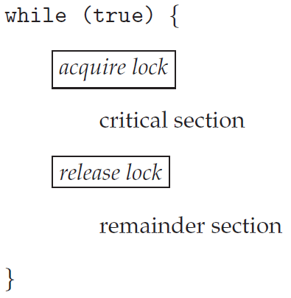
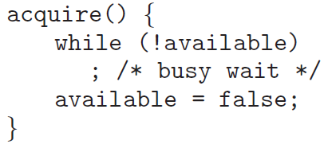
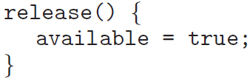
Solution to CS Problem Using Mutex Locks
The main disadvantage of the implementation given here is that it requires busy waiting.
Notes:
The remainder section does not require special attention.
Busy waiting: While loop

Slide 33
Semaphore
Synchronization tool that provides more sophisticated ways (than Mutex locks) for processes to synchronize their activities.
Semaphore S – integer variable
Can only be accessed via two indivisible (atomic) operations
wait() and signal()
Definition of the wait() operation
wait(S) {
while (S <= 0)
; // busy wait
S--;
}
Definition of the signal() operation
signal(S) {
S++;
}
Notes:
Even though mutex locks work, we introduce more sophisticated ways.
It ‘s also used in signaling.
Acquire and Release === Wait and signal
Semaphore can be seen as the number of available resources.

Slide 34
Semaphore (contd.)
Counting semaphore – integer value can range over an unrestricted domain
Binary semaphore – integer value can range only between 0 and 1
Same as a mutex lock
Can implement a counting semaphore S as a binary semaphore
With semaphores we can solve various synchronization problems
Notes:
Counting semaphore: No bound/limit on ++.
Binary semaphore: Can be used using 0/1.

Slide 35
Semaphore Usage Example
Solution to the CS Problem
Create a semaphore “mutex” initialized to 1
wait(mutex);
CS
signal(mutex);
Consider P₁ and P₂ that with two statements S₁ and S₂ and the requirement that S₁ to happen before S₂
Create a semaphore “synch” initialized to 0
P1:
S₁;
signal(synch);
P2:
wait(synch);
S₂;
Notes:
Requirement: S1 must be executed before S2.
We don’t know which process P1 or P2 will execute first.
If P2 executes 1st, it will wait till P1 executes and sends the signal to P2 that it has executed, and then S2 will be executed.
Problem of Mutex and Semaphore: Use signal and wait in proper place. Programmer should handle. Else there will be a problem for example deadlock.

Slide 36
Semaphore Implementation
Must guarantee that no two processes can execute the wait() and signal() on the same semaphore at the same time
Thus, the implementation becomes the critical section problem where the wait and signal code are placed in the critical section
Could now have busy waiting in critical section implementation
But implementation code is short
Little busy waiting if critical section rarely occupied
Note that applications may spend lots of time in critical sections and therefore this is not a good solution
Notes:
How to avoid busy waiting: 1 solution is to use a wait queue

Slide 37
Semaphore Implementation with no Busy waiting
With each semaphore there is an associated waiting queue
Each entry in a waiting queue has two data items:
Value (of type integer)
Pointer to next record in the list
Two operations:
block – place the process invoking the operation on the appropriate waiting queue
wakeup – remove one of processes in the waiting queue and place it in the ready queue
Notes:
OS provides a wait queue.
Add process to wait queue.
We need extra efforts like using a linked list.
A pointer contains a set of processes that are waiting in the queue.
Block: Put the process in the waiting queue which invokes this block.

Slide 38
Implementation with no Busy waiting (contd.)
Waiting queue
typedef struct {
int value;
struct process *list;
} semaphore;
Notes:
The list can be a Linked list or a Double Linked list.

Slide 39
Implementation with no Busy waiting (contd.)
wait(semaphore *S) {
S->value--;
if (S->value < 0) { add this process to S->list;
block();
}
}
signal(semaphore *S) {
S->value++;
if (S->value <= 0) { remove a process P from S->list;
wakeup(P);
}
}
Notes:
Add the calling process to the list and move to block.
This will come to life only when the resource is available which is when someone calls wakeup.
Value: Number of resources left (S is positive)/Number of processes in the wait queue (S is negative).
S=1: 1 resource available.
S=-2: 2 process in waiting queue

Slide 40
Semaphore Implementation
Semaphore operations must be executed atomically.
No two processes can execute wait() and signal() operations on the same semaphore at the same time.
Solution in a single-processor environment
Inhibiting interrupts during the time the wait() and signal() operations are executing
Solution in multicore environment
Interrupts must be disabled on every processing core.
Otherwise, instructions from different processes (running on different cores) may be interleaved in some arbitrary way.
Therefore, symmetric multiprocessing (SMP) systems must provide alternative techniques—such as compare_and_swap() or spinlocks—to ensure that wait() and signal() are performed atomically.
Notes:
symmetric multiprocessing (SMP), where each processor is self-scheduling.

Slide 41
Problems with Semaphores
Incorrect use of semaphore operations:
signal(mutex) …. wait(mutex)
wait(mutex) … wait(mutex)
Omitting of wait(mutex) and/or signal(mutex)
These – and others – are examples of what can occur when semaphores and other synchronization tools are used incorrectly.
Notes:
Proper use is important.

Slide 42
Monitors
A high-level abstraction that provides a convenient and effective mechanism for process synchronization
Abstract data type, internal variables only accessible by code within the procedure
Only one process may be active within the monitor at a time
Pseudocode syntax of a monitor:
monitor monitor-name
{
// shared variable declarations
procedure P1 (…) { …. }
procedure P2 (…) { …. }
procedure Pn (…) {……}
initialization_code (…) { … }
}
Notes:
It is up to the compiler to implement mutual exclusion on monitor entries, but a common way is to use a mutex or a binary semaphore.
It is an abstract datatype.
Ex: Stack, Linked List, Queue, etc.
If use them without knowing the internal implementation.
Only one process is active in the monitor.

Slide 43
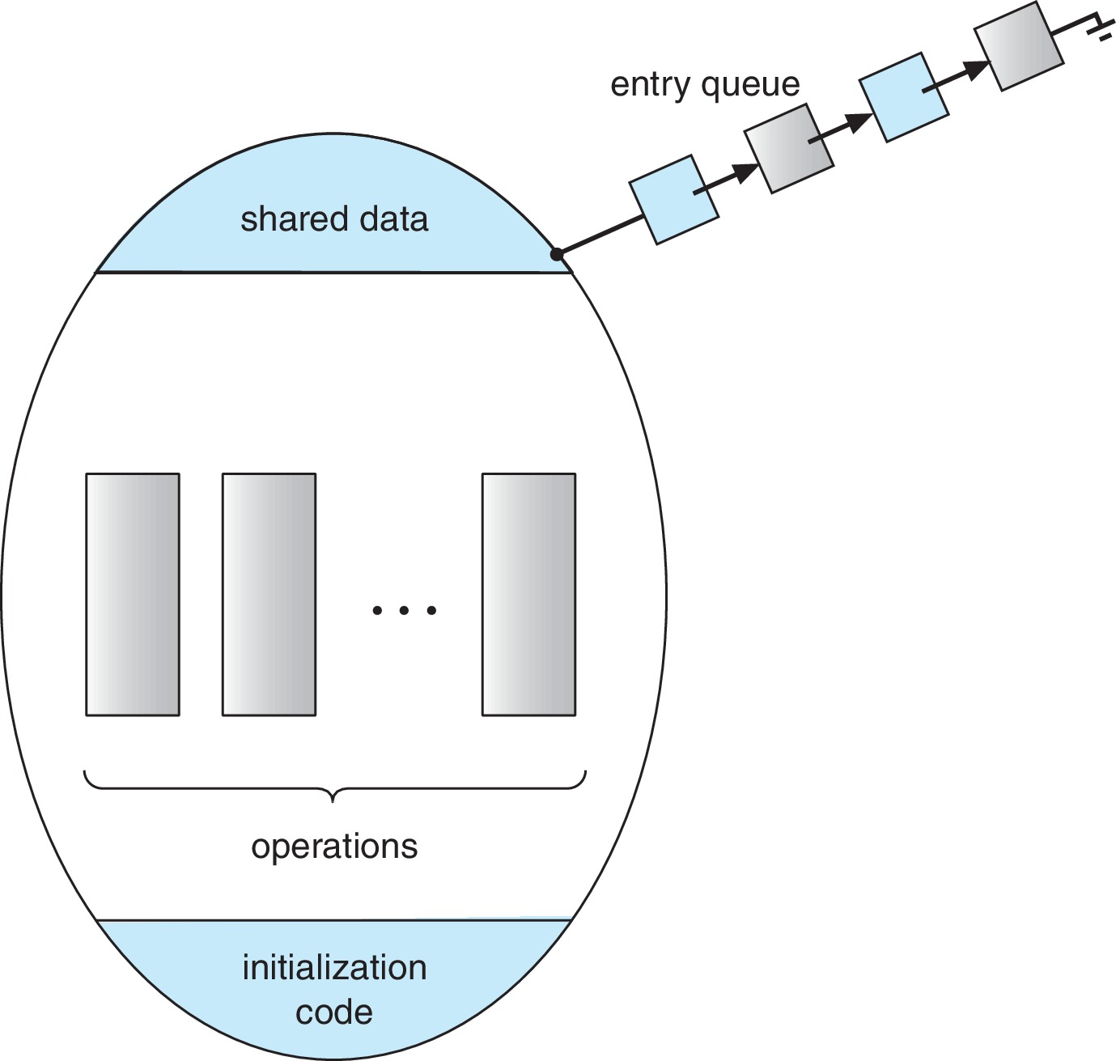
Schematic view of a Monitor
Notes:
If multiple processes are trying to enter the monitor, they will wait in the queue.

Slide 44
Monitor Implementation Using Semaphores
Variables
semaphore mutex
mutex = 1
Each procedure P is replaced by
wait(mutex);
…
body of P;
…
signal(mutex);
Mutual exclusion within a monitor is ensured
Notes:
Mutex is 0 or 1 – Yes or no.
1: Not lock;
0: Lock;
The wait is implemented in multiple ways.
This is the simplest execution: Spinning lock or busy waiting.
Usually, monitor implementation is not enough to solve all the problems discussed till now, such as producer-consumer problems.
How can we block the producer when the buffer is full, or block the consumer when the buffer is empty; there is no technique.
So we use condition variable.

Slide 45
Condition Variables
condition x, y;
Two operations are allowed on a condition variable:
x.wait() – a process that invokes the operation is suspended until x.signal()
x.signal() – resumes one of processes (if any) that invoked x.wait()
If no x.wait() on the variable, then it has no effect on the variable
Notes:
Wait until a certain condition is fulfilled.

Slide 46
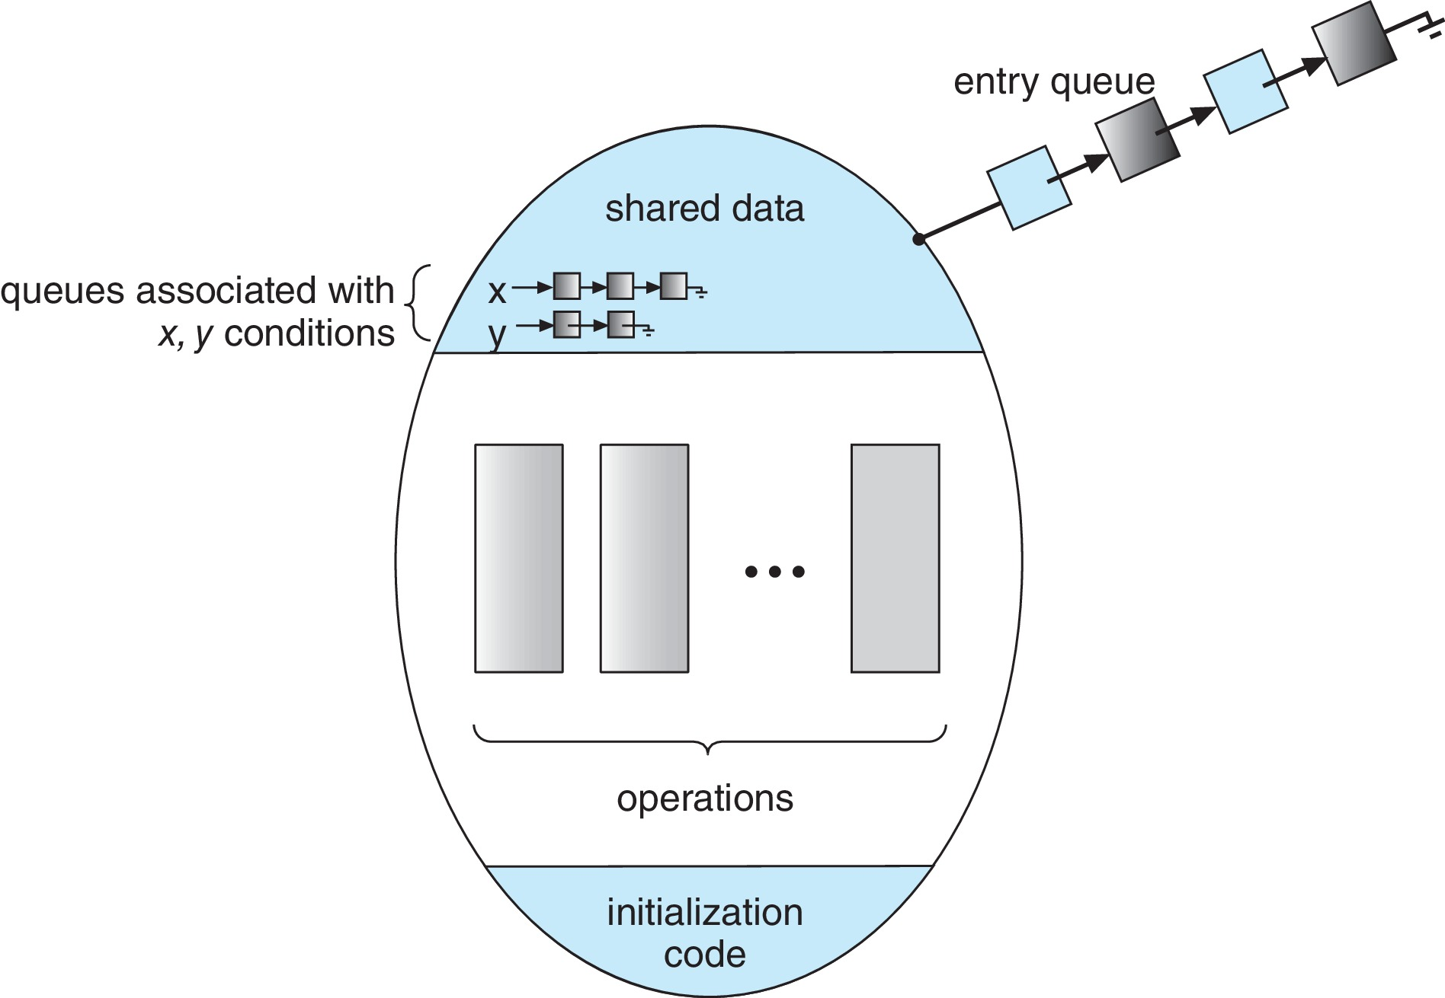
Monitor with Condition Variables
Notes:
We have an additional queue for each condition variable (x, y)
Condition queues are the processes that are in the monitor, but they are suspended.
We use semaphore mutex to hold the processes.
We need to use mutex for each condition variable separately.
Before suspending, we need to resume someother suspended procedures.
Signal and wait: If P is suspending and Q is resumed, it will not resume immediately. It will wait for P to may be exit the monitor.

Slide 47
Monitor Implementation Using Semaphores
Variables
semaphore mutex; // (initially = 1)
semaphore next; // (initially = 0)
int next_count = 0; // number of processes waiting
// inside the monitor
Each function P will be replaced by
wait(mutex);
…
body of P;
…
if (next_count > 0)
signal(next);
else
signal(mutex);
Mutual exclusion within a monitor is ensured
Notes:
Semaphore mutex: To have protection, only one process enters the monitor.
Semaphore next: Holds all the processes that are inside the monitor, which are in suspended mode.
If condition: There are processes inside the monitor waiting.
Else: No processes are waiting, allow the outer process to enter.

Slide 48
Implementation – Condition Variables
For each condition variable x, we have:
semaphore x_sem; // (initially = 0)
int x_count = 0; // number of process waiting
// on condition (x)
The operation x.wait() can be implemented as:
x_count++;
if (next_count > 0)
signal(next); // resume a suspended thread
else
signal(mutex); // allow a new thread in the monitor
wait(x_sem); // wait on the condition’s semaphore
x_count--;
Notes:
N: Condition variables, then we have N semaphores.
x_count: How many processes are waiting inside the monitor?

Slide 49
Implementation (contd.)
The operation x.signal() can be implemented as:
if (x_count > 0) {
next_count++;
signal(x_sem); // condition’s semaphore signal
wait(next); // semaphore wait
next_count--;
}
Notes:
Send signal only when someone is waiting in that condition variable.

Slide 50
Resuming Processes within a Monitor
If several processes queued on condition variable x, and x.signal() is executed, which process should be resumed?
FCFS frequently not adequate
Use the conditional-wait construct of the form
x.wait(c)
where:
c is an integer (called the priority number)
The process with the lowest number (highest priority) is scheduled next
Notes:
Which process should be resumed? We can pass some kind of priority, and the highest priority process will be resumed after we call x.signal().

Slide 51
A Monitor to Allocate Single Resource
monitor ResourceAllocator
{
boolean busy;
condition x;
void acquire(int time) {
if (busy)
x.wait(time);
busy = true;
}
void release() {
busy = false;
x.signal();
}
initialization_code() {
busy = false;
}
}
Notes:
Condition variables are used on if condition. If the system is busy, then we use the condition variable.

Slide 52
Single Resource Monitor (Cont.)
Usage:
acquire
...
release
Incorrect use of monitor operations
release() … acquire()
acquire() … acquire())
Omitting of acquire() and/or release()
Notes:
RA r;
e.acquire();
….
e.release()
Have some resource, after using release the resource.
We should use them in proper/correct order. [Deadlock may occur if not used in order]

Slide 53
Liveness
Processes may have to wait indefinitely while trying to acquire a synchronization tool such as a mutex lock or semaphore.
Waiting indefinitely violates the progress and bounded-waiting criteria discussed at the beginning of this chapter.
Liveness refers to a set of properties that a system must satisfy to ensure processes make progress.
Indefinite waiting is an example of a liveness failure.
Notes:
No tools [Hardware/Software] are perfect.
Use them based on situations.
Keeps waiting infinitely – It's not “live.”

Slide 54
Liveness
Deadlock – two or more processes are waiting indefinitely for an event that can be caused by only one of the waiting processes
Let S and Q be two semaphores initialized to 1
P₀ P₁
wait(S); wait(Q);
wait(Q); wait(S);
... ...
signal(S); signal(Q);
signal(Q); signal(S);
Consider if P₀ executes wait(S) and P₁ wait(Q). When P₀ executes wait(Q), it must wait until P₁ executes signal(Q)
However, P₁ is waiting until P₀ execute signal(S).
Since these signal() operations will never be executed, P₀ and P₁ are deadlocked.
Notes:
Nobody has used it, so the initial value is 1.

Slide 55
Liveness
Other forms of deadlock:
Starvation – indefinite blocking
A process may never be removed from the semaphore queue in which it is suspended
Priority Inversion – Scheduling problem when lower-priority process holds a lock needed by higher-priority process
Solved via priority-inheritance protocol
Notes:
Priority Inversion:
Imagine we have three processes: L, M, and H [Low, Medium, and High Priority].
Lower-priority processes hold the resources required by high-priority processes, so they wait, which should not happen.
Priority-inheritance protocol: Low priority will inherit the high priority process so that it wont be kicked off.

